Slide 1
Uncontrolled copy not subject to amendment
Airframes
Revision 1.00

Slide 2
Chapter 4:
Fuselage

Slide 3
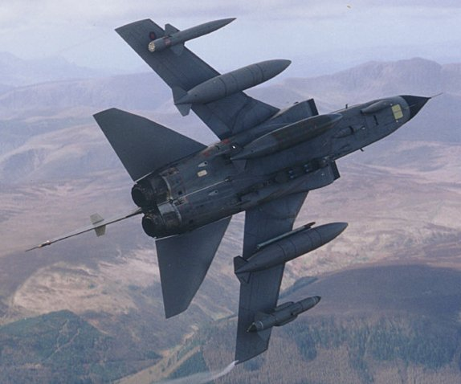

Slide 4
Learning Objectives
The purpose of this chapter is to discuss in more detail the first of the 4 major components few learned about in Chapter 1, the Fuselage.
By the end of the lesson you should have an understanding of the construction of the fuselage, and what loads and forces act upon them.
But first a recap of Chapter 3 with some questions.

Slide 5
Chapter 3 Revision
A couple of questions about the previous chapters.
Name one advantage of the ‘Extrusion’ process over the other material forming manufacturing processes?
What are the 3 main forging classes?
What does the acronym EDM stand for?
What is the most common Material Removal technique?

Slide 6
The Fuselage
Similar to the wing, the fuselage has many jobs to do. Can you think of any?
So, like the wing, the fuselage can do lots of different jobs, and most of the time, it does lots of them at the same time.
Add to this, most modern aircraft have some sort of pressurisation.
Carries Payload
Houses the undercarriage
It’s where the pilot and/or crew sit
Carries weapons
Houses the aircraft systems
House the engine or engines
Links the wings to the tail unit

Slide 7
Pressurisation
Why do you think they pressurise the air inside the fuselage?
When aircraft fly at high altitudes, they are more fuel efficient.
At such altitudes the passengers and crew would find it uncomfortable, or even impossible to survive.
So the inside air of the fuselage is pressurised to simulate a lower altitude, of around 2,400 metres (8,000 feet) for transport aircraft, and up to 7,600 metres (25,000 feet) for military aircraft (with crew oxygen).

Slide 8
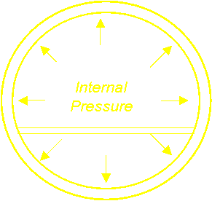
The Pressure Vessel
When we pressurise the air inside the fuselage, what happens to the structure the fuselage is made of?
These pressure forces will try to burst the fuselage like a balloon.
Therefore the fuselage is designed as a pressure vessel, in order to contain these forces.
Which is why the cross section of the fuselage is circular, as this is the best shape to contain the pressure.

Slide 9
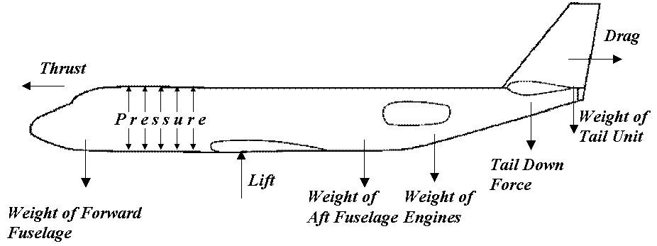
Fuselage Forces
As mentioned earlier, the fuselage forms a structural link between the wings and the tail unit.
It has to keep everything in the correct position and angles, and be capable of resisting the loads that they all impose upon it.
So all these forces are acting at the same time – another difficult structural problem for the aircraft designer.

Slide 10
Fuselage Sections
There are three distinct parts of the fuselage:
The nose section
The centre section
The aft or rear section
The three sections will carry different loads in accordance with the task the aircraft is required to do, but in all types the centre section needs to be large and strong. Why?
In flight, the whole aircraft will be supported by lift from the wings, transmitted through the centre of the fuselage to carry the other parts of the airframe.

Slide 11
Fuselage Shapes
Combat aircraft fuselages come in many complex shapes and sizes, this is due to the special tasks that they may have to accomplish.
However, in transport aircraft, the majority of the fuselage is tubular.
Why?

Slide 12
Fuselage Shapes
The reason is that this is a convenient shape for carrying cargo or passengers and makes it possible to stretch the aircraft.
This results in mainly cylindrical fuselages, with tapered nose and tail sections.
Stretching is achieved by inserting extra pieces or plugs without a major re-design of the fuselage.

Slide 13
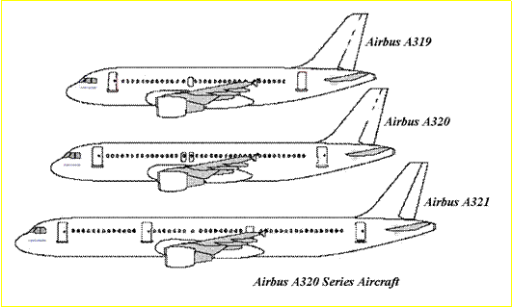
Stretched Airframe Examples

Slide 14
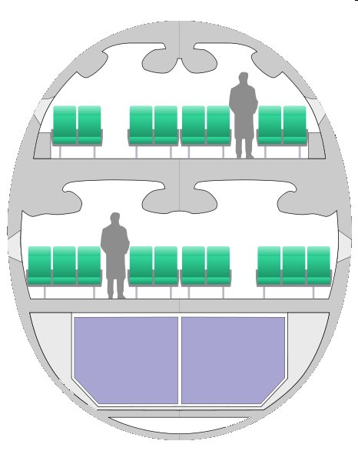
Double Deck Fuselages
There are some commercial aircraft that do not have a circular cross section.
The Airbus A380 and Boeing 747 ‘Jumbo Jet’ have a fuselage cross-section that is oval in shape.
This is to accommodate the double deck passenger section.

Slide 15
Methods of Construction
A similar method of construction to that used in the wings can be used for fuselages and tail units (or foreplanes)
In general, there are two methods of fuselage construction;
Welded Steel Truss
Monocoque Design
The welded steel truss was used extensively in aircraft designs in the interwar years.
Although superseded by monocoque designs, the welded steel truss is still used in some light aircraft and helicopters

Slide 16
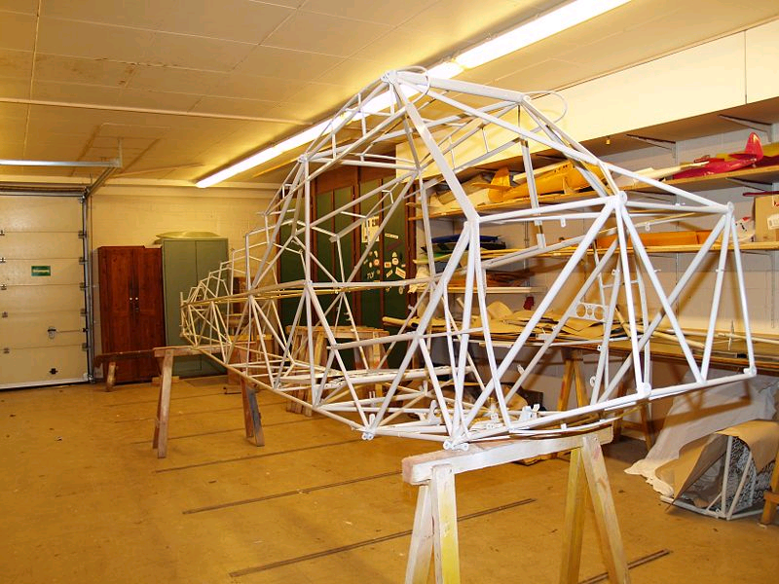
Welded Steel Truss Design
In a Welded Steel Truss, the structural elements resemble those of a bridge, with emphasis on using linked trianglular elements.
The aerodynamic shape is completed by additional elements called Frames and Stringers and is then covered with fabric, metal sheeting or composite.
The truss ensures a robust, uniform load bearing structure.

Slide 17
Monocoque Design
The monocoque design relies on the strength of the stressed skin within the airframe structure to share the loads, allowing for a much-reduced internal structure.
The monocoque design can be further sub-divided into three classes:
True Monocoque: Consists of formers, frame assemblies and bulkheads to provide shape with the skin carrying the primary stress, but suffers from poor strength to weight ratios
Semi-Monocoque: Overcomes the strength to weight ratio of the True Monocoque by reinforcing the skin with longitudinal members
Reinforced Shell: The skin is reinforced by a complete framework of structural members.

Slide 18
Semi-Monocoque Structures
A Semi-Monocoque fuselage is constructed primarily of Aluminium Alloy.
The primary loads are taken by the Longerons, which usually extend across several points of support, holding the bulkheads, frames and formers. These are supplemented by Stringers.
Stringers are more numerous and lighter in weight than Longerons.
Stringers have some rigidity, but are chiefly used for giving shape and allow attachment of the skin.
Stringers and Longerons prevent tension and compression stresses from bending the fuselage.

Slide 19
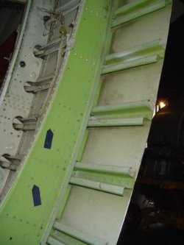
Semi-Monocoque Structures
The bulkheads and formers hold the stringers
All these structural elements join together to provide a rigid fuselage framework.
Frame
Stringer
The stressed skin is attached to the Longerons, Bulkheads and the other structural members. The stressed skin that carries part of the structural load of the airframe.
The skin thickness varies with the load being carried and the stresses sustained at given locations.
Stressed skin

Slide 20
Advantages of Semi-Monocoque
There are a number of advantages to utilising a semi-monocoque fuselage in a airframe design.
It leaves a large proportion of the inside free to accommodate crew, passengers and cargo
The Bulkhead, Frames, Stringers and Longerons aid in producing a streamlined fuselage and add to the strength and rigidity of the structure
As a semi-monocoque design relies on a number of structural members for strength and rigidity, the fuselage can withstand damage.
Loads from pressurisation can be up to 5600 kilogrammes force per square metre (that is a force equal to the weight of six cars for every square metre of fuselage skin. This is easier to achieve in semi-monocoque construction.

Slide 21
Pressure Bulkheads
A question – what makes the shell of an egg so strong?
The answer is the curvature of it’s shape!
The nose and tail of the fuselage uses double curvature bulkheads, like the surface of an egg, to make the skin even stiffer.
Pressure bulkheads are fitted in the nose and close to the tail of most aircraft. They are generally curved. Their job is to withstand the loads imposed by pressurisation of the fuselage.

Slide 22
Cabin Floor
For a civil airliner, the cabin will require a floor, consisting of beams across the inside of the fuselage and covered in sheet alloy or composite panels
This ensures a flat surface for walking on and fitting seats.
It also allows the designer to compartmentalise the fuselage
This leaves space for luggage and the many aircraft systems in the lower fuselage space.

Slide 23
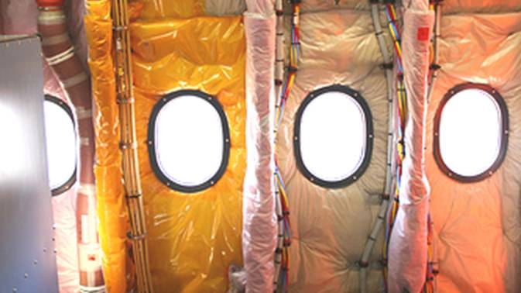
Windows & Doors
To allow for doors and windows, the fuselage must also include cut-outs, but this causes the engineers structural problems, why?
The fuselage needs to be strengthened around them.
It is important to make sure that loads can be routed around these cut-outs, and spread evenly into surrounding skin and structure.
The ideal shape for a cut-out in a fuselage is an ellipse, and many aircraft have windows this shape.

Slide 24
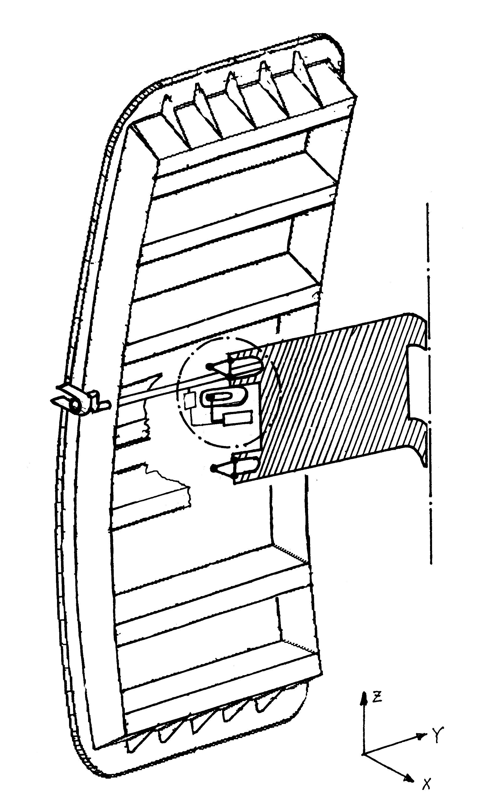
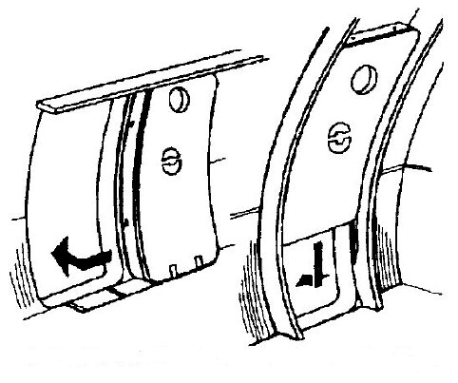
Cabin Door Types
Oval shapes are not very practical for doors, and the more usual shape is a rectangular with rounded corners.
The 2 examples ‘A’ & ‘B’ are opened inwards ,and so form a ‘plug’ when closed.
Most modern aircraft have outward opening doors though.
A. ‘Pull in and Slide’ B. ‘Up and Over’ Modern Cabin Door

Slide 25
Cargo Doors
Airframes must also include other access doors for maintenance and allow stowage of those components not required for flight, such as the undercarriage.
In particular the cargo compartment needs a door, and some aircraft designed for transporting cargo have larger doors.
These still need to resist the cabin pressure and maintain the strength of the fuselage.

Slide 26
Combat Aircraft
At the beginning of this chapter, we said that combat aircraft fuselages can be quite different from other aircraft.
The pressurised space is usually smaller, containing just the cockpit and perhaps an electronics bay, and pressures are much lower, because the pilot also uses an oxygen mask.
Additionally, the fuselage will probably have a strong beam, called the ‘keel beam’.
This runs fore and aft, and many of the major parts, like the engines, cannon and undercarriage are mounted to it.

Slide 27
Conclusions
Far from the fuselage being a simple structural component of the airframe, it is itself a complex assembly. The fuselage has to be able to cope with not only those loads exerted on it during flight, but it also must cope with being pressurised.
It also needs to be spacious, in order to accommodate passengers and cargo, but yet structurally strong and rigid to withstand the loads.
You should now have an understanding of both the function of the fuselage, the methods of construction and the specific considerations that need to be addressed during it’s design.
Any Questions?

Slide 28
Questions
Here are some questions for you!
What are the 3 distinct parts of a fuselage?
Why are civil airliner fuselages generally circular in section?
What is a semi-monocoque fuselage?
What forces and loads must the fuselage cope with?

